Slide 1
MET CS 555 – Foundations of Machine Learning Lecture 8: Regression Diagnostics
Hongsheng Wu
Boston University

Slide 2
Study Guide
Regression Diagnostics

Slide 3
Regression Diagnostics

Slide 4
Regression Diagnostics
Determine whether all the necessary model assumptions are valid before performing an inference
If there are any violations, subsequent inferential procedures may be invalid, resulting in faulty conclusions
In Regression Diagnostics, we check if the assumptions are met in order to have confidence in the inferences
These techniques involve visualizing
We look for issues with violations of the assumptions of the regression model

Slide 5
Residual Plots
Residual plots help visualize how well a regression equation fits the sample data
Residual plots are scatterplots of the regression residuals (y-axis) against the explanatory variable (x-axis)
The residual plot turns the regression line into the horizontal line to see patterns and unusual observations

Slide 6
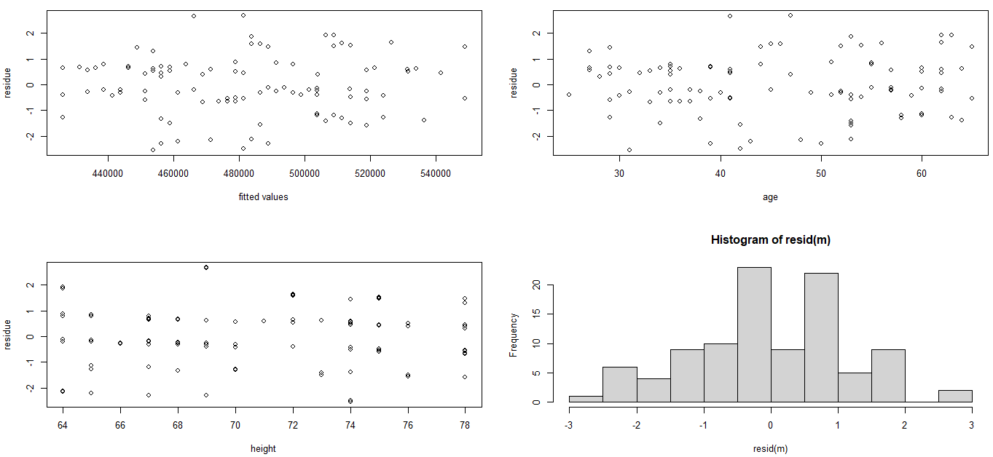
Residual Plots
> data<-read.csv(“CEO_salary.csv”)
> attach (data)
> m<-lm(salary~age+height)
Residual plots can also be generated using the predicted values on the x-axis as opposed to the explanatory variable (especially more useful when MLR)
Residual plots can also be generated by plotting standardized or studentized residuals¹ (which involves dividing the residual by an estimate of the variability of the residuals)

Slide 7
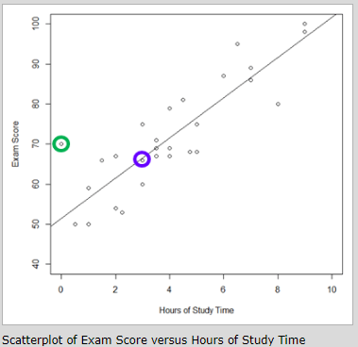
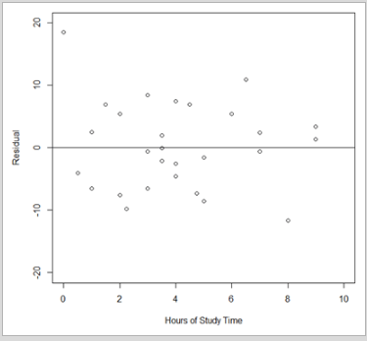
Exercise
Can you find the residual points in the residual plot that corresponds to the circled points in the original plot?

Slide 8
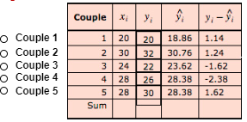
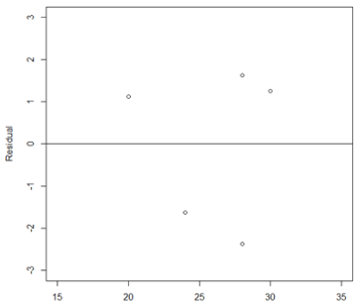
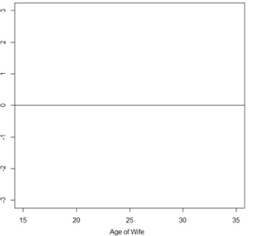
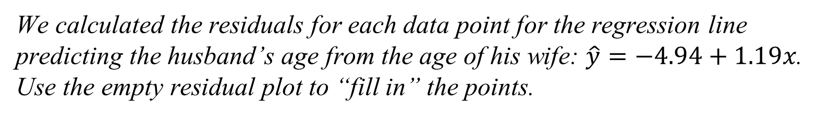
Exercise
We calculated the residuals for each data point for the regression line predicting the husband’s age from the age of his wife: $\hat{y}=−4.94+1.19x$. Use the empty residual plot to “fill in” the points.

Slide 9
Outliers and Influence Points
Outliers:
Outliers are observations that lie outside the overall pattern of the other observations
Outliers can be identified via a review of the scatterplot
Outliers in the y-direction tend to have large residuals
Outliers in the x-direction may or may not have large residuals but have the potential to be influential
Influence Point:
An influence point is an observation that markedly changes the result of the regression if it were to be removed from the calculation

Slide 10
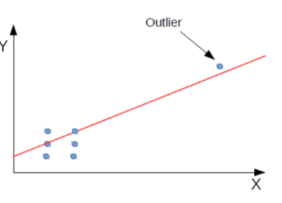
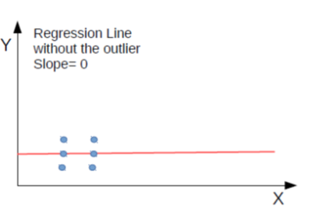
Outliers and Influence Points
Least-squares regression is based on minimizing the squared vertical distances between the observations and the regression line (L-2 norm), extreme points in the x-direction tend to pull the regression line close to itself
In these cases, the regression line equation may be quite different with or without the points and thus the points influence the regression equation
The influence of a particular point should be examined by removing it from the regression calculation and checking how the equations, inferences, and conclusions change with its removal.
Notes:
L2

Slide 11
Outliers and Influence Points
When there are outliers, we should always check to ensure that there was not an issue with data entry/recording
If an outlier in the x-direction, for example, is kept, it may be desirable to collect additional data within the same range to better characterize the relationship so that the regression doesn't depend so heavily on the data from a single observation
Notes:
L2

Slide 12
4 Principal Assumptions of the Least Square Regression
The following conditions must all be met before it is appropriate to make an inference from a least-squares regression:
1. The true relationship is linear
2. The observations are independent
3. The variation of the response variable around the regression line is constant (Constance Variance)
4. The residuals are normally distributed
If any of these are violated, then the inference, prediction, and interpretation of the regression equation (or correlation) are inefficient (at best) or misleading/biased/incorrect (at worst)

Slide 13
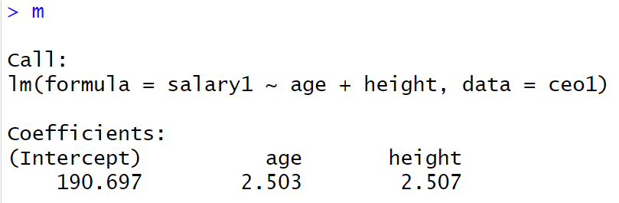
Linearity and Additivity of the Relationship
Linearity and additivity of the relationship between dependent and independent variables:
The expected value of the dependent variable is a straight-line function of each independent variable, holding the others fixed
Slope does not depend on the values of the other variables
The effects of different independent variables on the expected value of the dependent variable are additive

Slide 14
Regression Diagnostics
Check the assumptions:
1. Linearity
2. Independence
3. Constance variance
4. Normally distributed residuals

Slide 15
Linearity
Generate a scatterplot to visualize a roughly linear trend between factors.
Be cautious of curved or other non-linear relationships
Residual plots can help assess the assumption as they can magnify non-linearity
Violations of linearity or additivity are extremely serious: your predictions might be seriously in error when data are non-linearly or non-additively related.
Examples of violations:

Slide 16
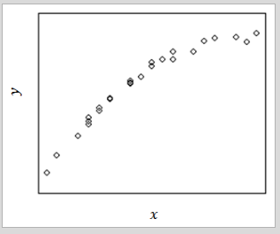
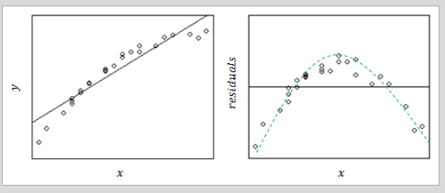
Example
Is this linearity?
The residual plot should show a random scattering of points; however, it appears there is a defined curved relationship.

Slide 17
Independence
We assume that the observations are independent.
Example:
Assume we are summarizing data on heights and weights in children, e.g., we only take one observation per child (as opposed to repeated measurements: multiple observations of the same child over time or observations on various sets of identical twins).
Correlated Data:
Observations on correlated data require more sophisticated analysis to account for the correlation between observations.

Slide 18
Constant Variance
We assume that the variability of the response is constant across the regression line
This particular assumption can be checked via a residual plot
The residual plot should show approximately the same amount of scatter from left to right
Examples of violations:

Slide 19
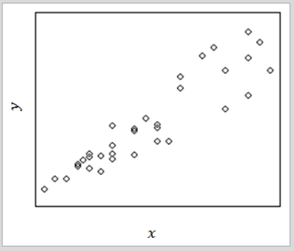
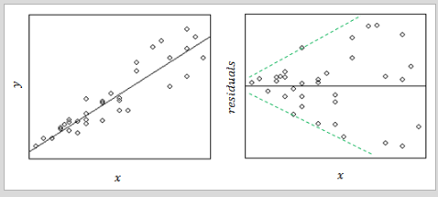
Example
Does this hold the constant variance assumption

Slide 20
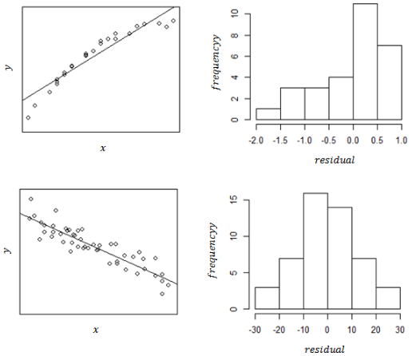
Normality
The residuals should follow a normal distribution
Severe deviations from this assumption could be due to outliers or non-normality of the explanatory or response variables
Residuals may not be normally distributed if the linearity assumption has been violated
Fortunately, the inference is not as sensitive to departures from this assumption, especially when the number of observations is large
To check this assumption, use histograms of the residuals

Slide 21
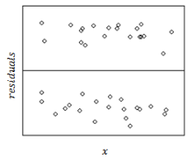
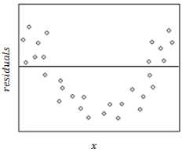
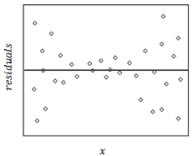
Exercise
Match the residual plot with the assumption violated: Constant Variance, Linearity, or Non-normality.
Non-normality: the residuals are not normally distributed, though they do see to show constant variance and lack of curvature. If we did a histogram of the residuals, we’d see a bimodal distribution, with no residuals at 00, and most of them far from 0 in either the positive or negative direction Linearity: we see a curved relationship between the explanatory variable and the residuals Constant variance: In this plot, the closer x gets to the mean (center) the less scatter or less variability there is in the residuals

Slide 22
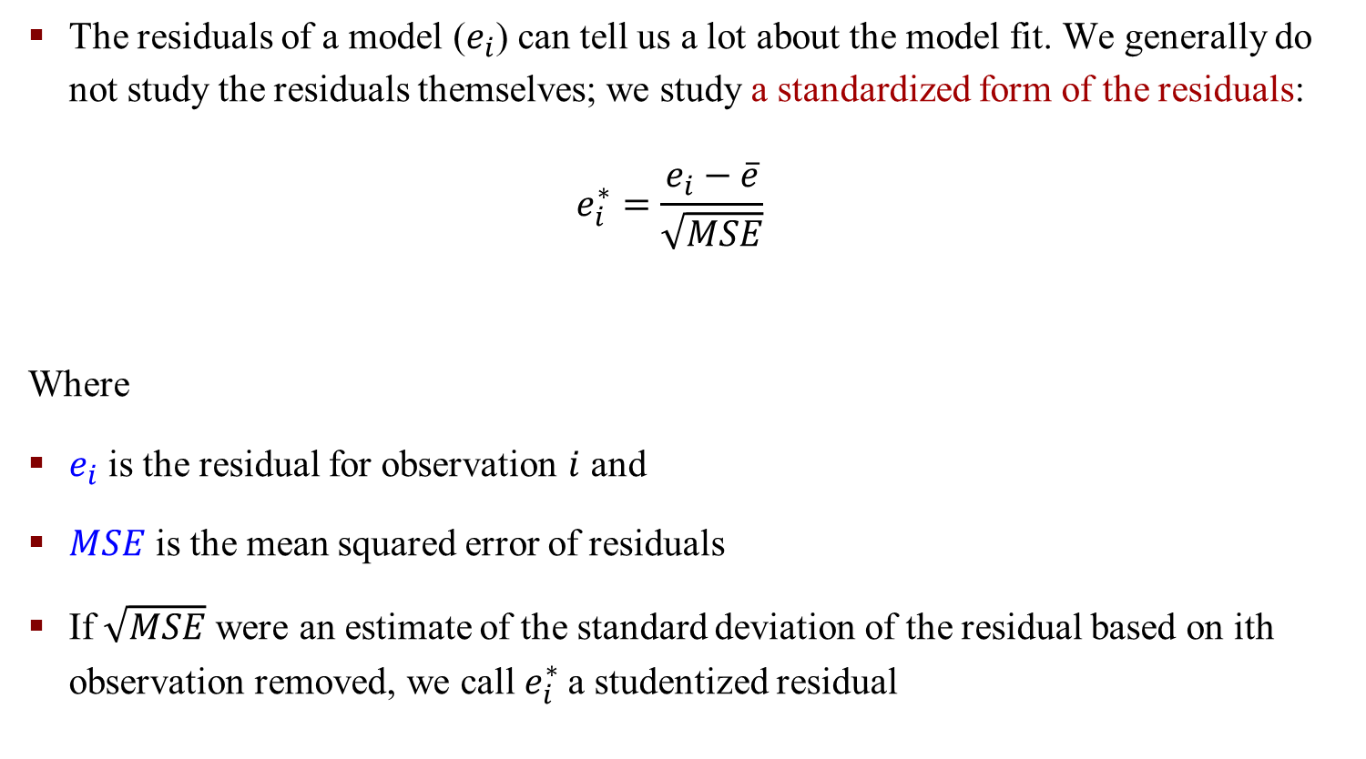
Standardized and Studentized Residuals
The residuals of a model ($e_{i}$) can tell us a lot about the model fit. We generally do not study the residuals themselves; we study a standardized form of the residuals:
$$e_{i}^{∗}=\frac{e_{i}−\overline{e}}{\sqrt{MSE}}$$
Where
$e_{i}$ is the residual for observation $i$ and
$MSE$ is the mean squared error of residuals
If $\sqrt{MSE}$ were an estimate of the standard deviation of the residual based on ith observation removed, we call $e_{i}^{∗}$a studentized residual
Notes:
When trying to identify outliers, one problem that can arise is when there is a potential outlier that influences the regression model to such an extent that the estimated regression function is "pulled" towards the potential outlier, so that it isn't flagged as an outlier using the standardized residual criterion. To address this issue, studentized residuals offer an alternative criterion for identifying outliers. The basic idea is to delete the observations one at a time, each time refitting the regression model on the remaining n–1 observations. Then, we compare the observed response values to their fitted values based on the models with the i^{th} observation deleted. This produces deleted residuals. Standardizing the deleted residuals produces studentized residuals.

Slide 23
Transformations
Assumptions of regression are violated?
Transformations can often help and be applied. If the variance of the response increases/decreases as the explanatory variable increases/decreases, then either
the natural log (ln) or
the square root function can be applied to the response variable to help “stabilize” the variance
If there is a non-linear relationship between factors, then sometimes squaring the explanatory variable (or adding a squared term to a multiple linear regression model) can help
Finding the right transformation often involves some trial and error. (See sections 11.10 and 11.1 in R Cookbook on transformations)
If transformation only marginally improves, then no transformation is preferred (Due to the increased complexity)

Slide 24
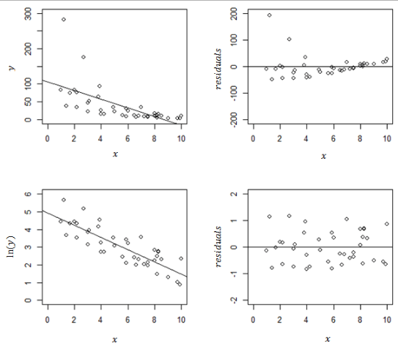
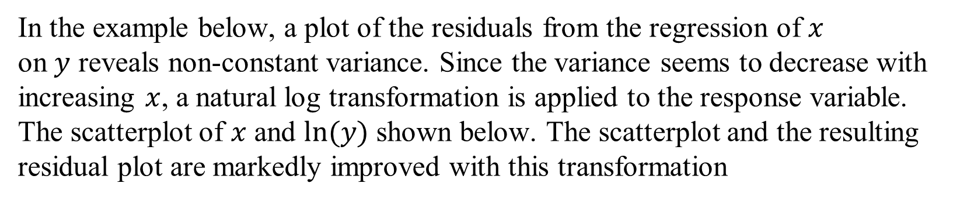
Example
In the example below, a plot of the residuals from the regression of $x$ on $y$ reveals non-constant variance. Since the variance seems to decrease with increasing $x$, a natural log transformation is applied to the response variable. The scatterplot of $x$ and $ln⁡(y)$ shown below. The scatterplot and the resulting residual plot are markedly improved with this transformation

Slide 25
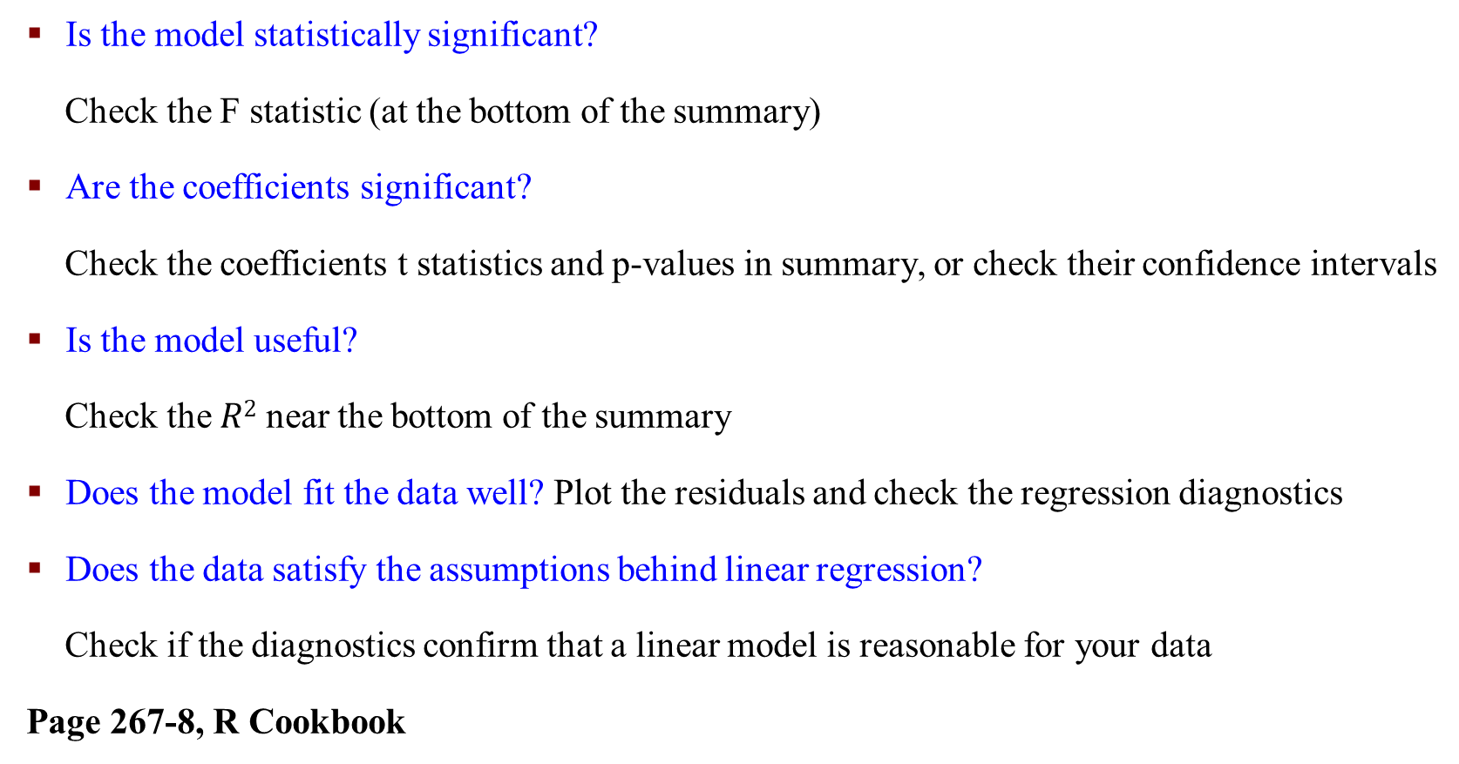
Summary: Check the Linear Model You Built
Is the model statistically significant?
Check the F statistic (at the bottom of the summary)
Are the coefficients significant?
Check the coefficients t statistics and p-values in summary, or check their confidence intervals
Is the model useful?
Check the $R2$ near the bottom of the summary
Does the model fit the data well? Plot the residuals and check the regression diagnostics
Does the data satisfy the assumptions behind linear regression?
Check if the diagnostics confirm that a linear model is reasonable for your data
Page 267-8, R Cookbook

Slide 26
Extrapolation
Extrapolation is the incorrect application of a regression equation outside of the range of data studied
Interpolation produces estimates between known observations
Extrapolation is subject to greater uncertainty and a higher risk of producing meaningless results

Slide 27
Lurking Variables
Often, there are variables that are not measured but have a strong influence on a dependent or an independent variable. Such variables are called lurking variables (aka confounding)
You should always consider this when interpreting regression results
Example: Consider the correlation between study time and grade score. Many other hidden variables might have an impact on the final grade score.
Variables like stress level of a person, amount of sleep per day, motivation score, etc. . . .
Notes:
Lurking 潜伏

Slide 28
Causation and Association
Linear regression is useful for understanding and quantifying associations - which is not the same as determining causation
The regression shows that changes in the explanatory variables are associated with changes in the response variable. It is not the causing changes in the response variable
Example:
The amount of milk consumed in a country might be correlated to the number of forest fires
- But it does not mean that it caused that
- Sometimes, you might find a third factor that connects things, like weather
It is easy to find a correlation, but it is hard to prove causation.
Notes:
Causation 因果关系

Slide 29
Causation and Association
To show causation, an experiment where you change the independent variable in specific ways and observe the resulting effect on the response is the most convincing way to evaluate it
For an experiment, we try to provoke a response by doing some actions
Experiments are often expensive and not always ethical to conduct (for Example, medical research)
If an experiment cannot be performed, then in order to begin to suggest that a causal relationship may apply, we'd want to see that the association was strong, the association is consistent across many different studies, the cause precedes the effect temporally, and the cause is plausible (scientifically and practically)
Notes:
provoke惹

Slide 30
Multicollinearity
When two or more independent variables are highly correlated, entering both into a multiple linear regression model may be problematic as the effect of each may cancel the other out
This phenomenon is called collinearity or multicollinearity. Multicollinearity increases the standard errors of the coefficients
Increased SE means some regression coefficients are close to 0 Multicollinearity makes some variables statistically insignificant when they should be significant

Slide 31
Multicollinearity
What to do?
Look at each independent variable's association with the dependent variable separately before looking at them together as well as examining the relationship between independent variables
If two independent variables are highly correlated (correlation > 0.8), then it may be advisable only to select one for inclusion in the regression

Slide 32
Warning Signs of Multicollinearity
Severe multicollinearity is a major problem because it increases the variance of the regression coefficients, making them unstable.
Here are some things to watch for:
1. A regression coefficient is not significant even though, theoretically, that variable should be highly correlated with Y
2. When you add or delete an X variable, the regression coefficients change dramatically
3. You see a negative regression coefficient when your response should increase along with X
4. You see a positive regression coefficient when the response should decrease as X increases
5. Your X variables have high pairwise correlations

